Slide 1
Better Logging to Improve Interactive Data Analysis Tools
Sara Alspaugh . . . . . . . . . alspaugh@eecs.berkeley.edu
Archana Ganapathi . . . . . . . aganapathi@splunk.com
Marti Hearst . . . . . . . . . . . . . . hearst@berkeley.edu
Randy Katz . . . . . . . . . . . . . randy@eecs.berkeley.edu
Notes:
My name is Sara. I’m a graduate student at UC Berkeley’s AMPLab.
This work is in collaboration with my advisors, Marti and Randy, and my colleague Archana at Splunk, a company that makes software managing and analyzing log data.
We’re interested in making tools for interactive data exploration and analysis more intelligent by mining records of user activity from these systems.
In this process we’ve learned something about what kinds of interaction data is recorded from analysis tools.
This talk grew out of conversations with colleagues at other data analytics companies who we talked to about this and wanted to know what they could do to make sure they collected quality activity records from their systems, so they could mine that and feed it back in to improving their product.
So that’s what this talk is about – how you can improve what data you log about your data analysis tool usage.

Slide 2
09-28-2012 18:28:01.134 -0700 INFO AuditLogger - Audit:[timestamp=09-28-2012 18:28:01.134, user=splunk-system-user,
action=search, info=granted, search_id=‘scheduler__nobody__testing__RMD56569fcf2f137b840_at_1348882080_101256’, search=‘search index=_internal metrics
per_sourcetype_thruput | head 100’, autojoin=‘1', buckets=0,
ttl=120, max_count=500000, maxtime=8640000, enable\_lookups=‘1', extra_fields=‘’, apiStartTime=‘ZERO_TIME', apiEndTime=‘Fri Sep 28 18:28:00 2012', savedsearch_name=“sample scheduled search for dashboards (existing job case)”]
event
Notes:
Before I get to our main recommendations, I’ll provide some context to make sure we’re all on the same page.
Logs generally contain collections of events. This is an example of a such an event, from Splunk.
There is a lot of variety in exactly what information is contained in such events and how it is formatted, but there are a few pieces of information that are usually there.

Slide 3
timestamp
09-28-2012 18:28:01.134 -0700 INFO AuditLogger - Audit:[timestamp=09-28-2012 18:28:01.134, user=splunk-system-user,
action=search, info=granted, search_id=‘scheduler__nobody__testing__RMD56569fcf2f137b840_at_1348882080_101256’, search=‘search index=_internal metrics
per_sourcetype_thruput | head 100’, autojoin=‘1', buckets=0,
ttl=120, max_count=500000, maxtime=8640000, enable\_lookups=‘1', extra_fields=‘’, apiStartTime=‘ZERO_TIME', apiEndTime=‘Fri Sep 28 18:28:00 2012', savedsearch_name=“sample scheduled search for dashboards (existing job case)”]
event
Notes:
That includes a timestamp.

Slide 4
timestamp
user
09-28-2012 18:28:01.134 -0700 INFO AuditLogger - Audit:[timestamp=09-28-2012 18:28:01.134, user=splunk-system-user,
action=search, info=granted, search_id=‘scheduler__nobody__testing__RMD56569fcf2f137b840_at_1348882080_101256’, search=‘search index=_internal metrics
per_sourcetype_thruput | head 100’, autojoin=‘1', buckets=0,
ttl=120, max_count=500000, maxtime=8640000, enable\_lookups=‘1', extra_fields=‘’, apiStartTime=‘ZERO_TIME', apiEndTime=‘Fri Sep 28 18:28:00 2012', savedsearch_name=“sample scheduled search for dashboards (existing job case)”]
event
Notes:
The user whose action ultimately generated the event.

Slide 5
timestamp
user
09-28-2012 18:28:01.134 -0700 INFO AuditLogger - Audit:[timestamp=09-28-2012 18:28:01.134, user=splunk-system-user,
action=search, info=granted, search_id=‘scheduler__nobody__testing__RMD56569fcf2f137b840_at_1348882080_101256’, search=‘search index=_internal metrics
per_sourcetype_thruput | head 100’, autojoin=‘1', buckets=0,
ttl=120, max_count=500000, maxtime=8640000, enable\_lookups=‘1', extra_fields=‘’, apiStartTime=‘ZERO_TIME', apiEndTime=‘Fri Sep 28 18:28:00 2012', savedsearch_name=“sample scheduled search for dashboards (existing job case)”]
event
action
Notes:
And the record of the action it self.
In data analysis systems, this is often some operation that transforms the data that the user is analyzing.
It may be, as in this case, a query. Or it may be a function that was called ultimately as a result of a button press.

Slide 6
timestamp
user
09-28-2012 18:28:01.134 -0700 INFO AuditLogger - Audit:[timestamp=09-28-2012 18:28:01.134, user=splunk-system-user, action=search, info=granted, search_id=‘scheduler__nobody__testing__RMD56569fcf2f137b840_at_1348882080_101256’, search=‘search index=_internal metrics per_sourcetype_thruput | head 100’, autojoin=‘1', buckets=0, ttl=120, max_count=500000, maxtime=8640000, enable\_lookups=‘1', extra_fields=‘’, apiStartTime=‘ZERO_TIME', apiEndTime=‘Fri Sep 28 18:28:00 2012', savedsearch_name=“sample scheduled search for dashboards (existing job case)”]
event
parameters
execution environment
configuration and version
stack trace
action
Notes:
And it can also contain other information, such as function parameters, execution environment, configuration and version information, or a stack trace.
Such events are logged primarily for debugging systems.
So what can this lowly log event tell us about interactive data exploration and analysis? What can’t it? What is missing? What is present? That is what this talk is about. We want better logging.
People have talked about logging – its an old topic, but we we are taking it up anew in the rising popularity of big data because we’ve found it’s lacking for interactive systems like what the IDEA workshop concerns itself with.

Slide 7
Why do we need better logging?
Motivation
Notes:
But why?

Slide 9
Notes:
Too small … use control-plus to make everying larger in this view (and make the width of the browser smaller)

Slide 10


Slide 11
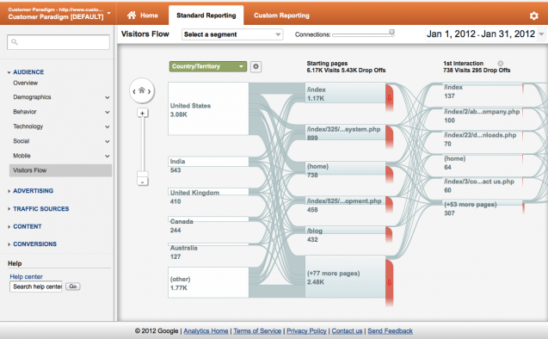
Google Analytics Goal Flow Visualization
Notes:
What is this a picture of? should at least have a title on top and a subtitle on the bottom that explains the main point.
Why am I seeing this?

Slide 12
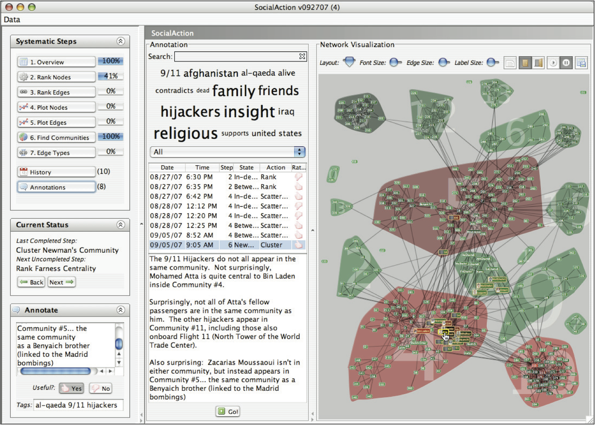
Notes:
I got lost in your explanation of this; maybe not show this viz at all and instead just describe the SYF ideas at their core (maybe just the nav menu on the far left).

Slide 13
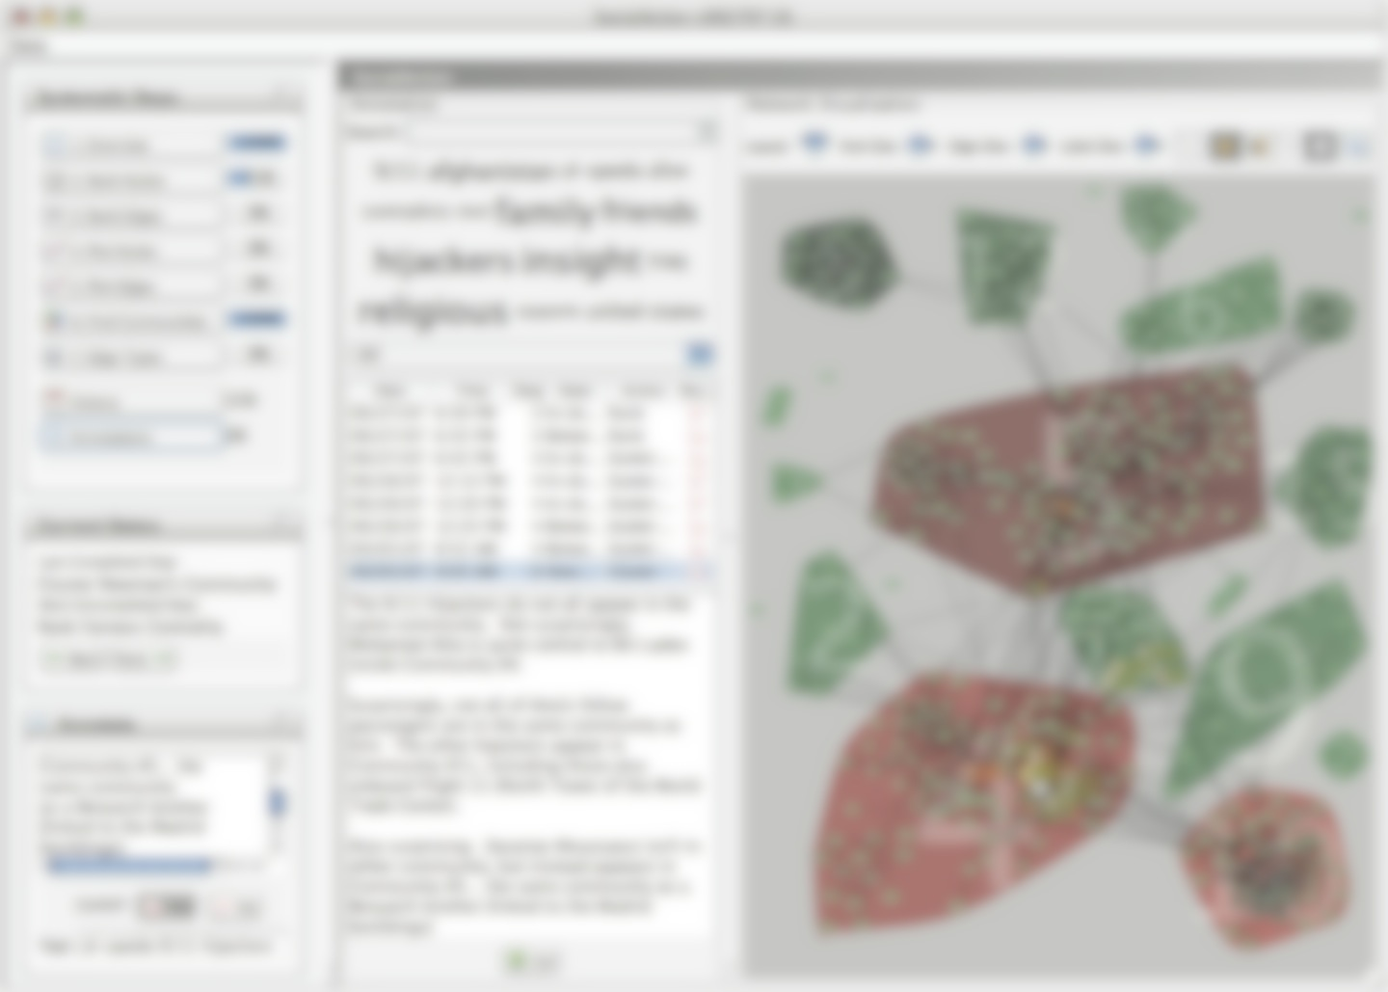
“Understanding the domain experts’ tasks is necessary to defining the systematic steps for guided discovery. Although some professions such as physicians, field biologists, and forensic scientists have specific methodologies defined for accomplishing tasks, this is rarer in data analysis. Interviewing analysts, reviewing current software approaches, and tabulating techniques common in research publications are important ways to deduce these steps.”
Notes:
This overlay is hard to read … put it on a white background on top of the overlay.

Slide 14
Some problems with logging
ISCE study of top six open source projects
“often a subjective and arbitrary practice”
“seldom a core feature provided by the vendors”
“written as “after-thoughts” after a failure”
“arbitrary decisions on when, what and where to log”
Notes:
“Despite the importance of log messages, logging is often a subjective and arbitrary practice in reality. In general, there is no rigorous specification or systematic process on software logging, partially because logging is seldom a core feature provided by the vendors. Therefore, in many cases, log messages are written as “after-thoughts” after a failure happens and logs are needed. There are a number of logging libraries, such as syslog [28] and log4j [16], that provide better logging interface (e.g., multiple verbosity levels) than general-purpose output functions (e.g., printf). But even with them, it is still the developers’ arbitrary decisions on when, what and where to log.”

Slide 15

“. . . it is critical to gain access to a stream of user actions. Unfortunately, systems and applications have not been written with an eye to user modeling."
Notes:
Need to put the cite here for Lumiere.
Is it really fair to show clippy?
include some info about lumiere – maybe use other art or arrow from lumiere to clippy

Slide 16
Recommendations
Plan ahead to capture high-level user actions when designing the system.
Track detailed provenance for all events.
Observe intermediate user actions that are not “submitted” to the system.
Record the metadata and statistics of the data set being analyzed.
Collect user goals and feedback.
Work towards a standard for logging data analysis activity records.

Slide 17
Plan ahead to capture high-level user actions when designing the system.
Recommendation #1
Notes:
Need to add a slide before this one about a set of high level recommendations for improving logs.
This is based on looking at Splunk data and other things.
also need a slide about privacy of data. We assume an opt in model. So when an organiziatoin or individual is ready to have a model trained on their data, the logs will be suitable for learning and recommendations.

Slide 18
Notes:
Example: identifying the user’s task in Excel
Example: HARVEST as a solution
quote from Excel paper about recognizing streams of such actions
keep in mind how easy / hard the metaphors you use in the interface will make it hard to deduce what the user is doing
For this slide you need a title: User Task: Clustering in Excel

Slide 19
Notes:
TODO: fix LaTeX quotes

Slide 20
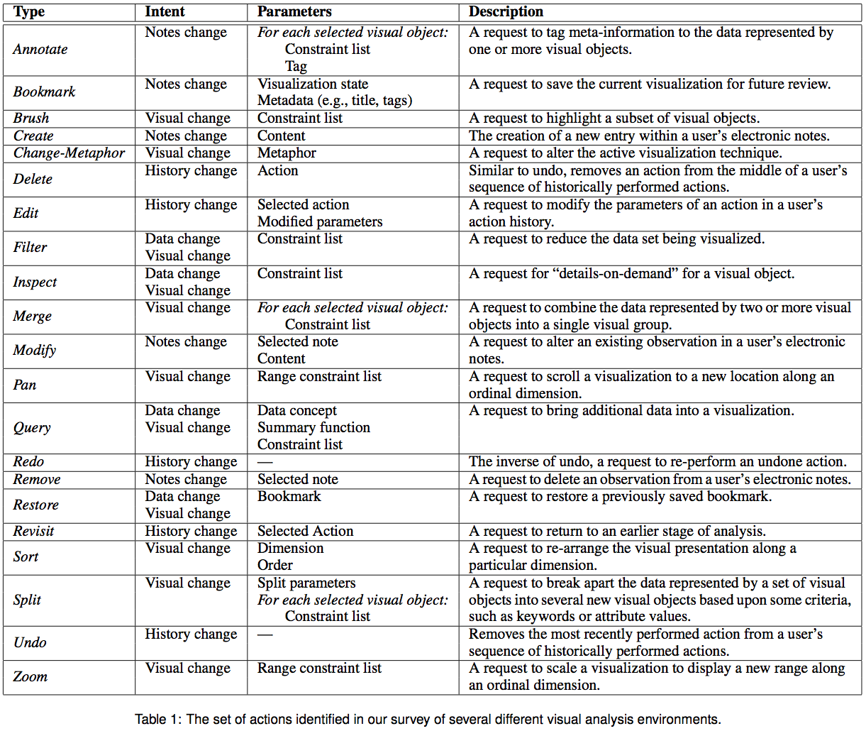
Notes:
Make a slide that introduces Harvest: Harvest is a web-based visual analysis tool that incorporates semantic actions as a core design element (maybe show the picture on page 129 upper right) by Gotz and Zhou of IBM; (Michelle Zhou may be in the audience) . Now say what your point is about this paper.

Slide 21
Track detailed provenance for all events.
Recommendation #2
Notes:
Example: data-cleaning problems with Splunk
diagram of all possible source things could be logged in funnel view
quote from Tableau
Do you really want to say ALL events? Or just important ones?

Slide 22
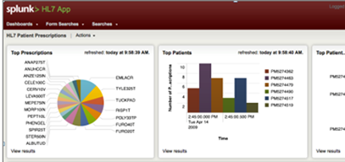
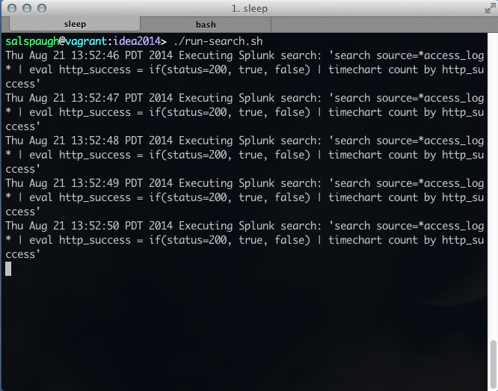
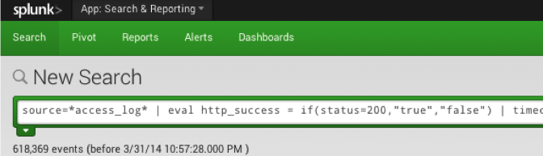
sources
triggered by dashboard reload
issued from external user script
interactively entered at search bar
same event logged
09-28-2012 18:28:01.134 -0700 INFO AuditLogger - Audit:[timestamp=09-28-2012 18:28:01.134, user=salspaugh, action=search, info=granted , search_id=`scheduler__nobody__testing__RMD56569fcf2f137b840_at_1348882080_101256', search=`search source=*access_log* | eval http_success = if(status=200, true, false) | timechart count by http_success’, autojoin=`1', buckets=0, ttl=120, max_count=500000, maxtime=8640000, enable\_lookups=`1', extra_fields=`', apiStartTime=`ZERO_TIME', apiEndTime=`Fri Sep 28 18:28:00 2012', savedsearch_name=“”]

Slide 23
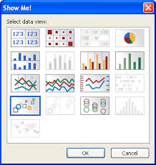
“...the log files do not differentiate between Show Me and Show Me Alternatives. These commands are implemented with the same code and the log entry is generated when the command is successfully executed.”
Notes:
Need to label this as being from TableauSoftware.
You might toss in the comments about versions of software as well. and parameter settings.

Slide 24
Observe intermediate user actions that are not “submitted” to the system.
Recommendation #N
Notes:
image of google autocomplete
menu jitter / flailing / heatmap
Put an asterisk for privacy considerations … I would probably omit this one altogether.

Slide 25
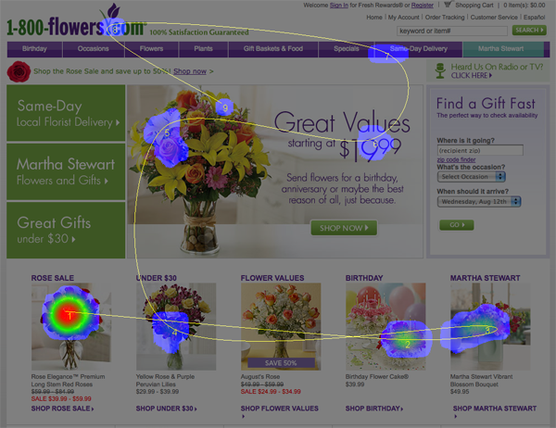
Notes:
source: normalmodes.com

Slide 26
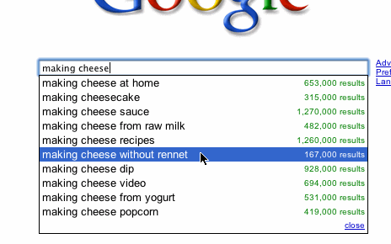

Slide 27
Record the metadata and statistics of the data set being analyzed.
Recommendation #3
Notes:
Example: making recommendations in Splunk
diagram – bayesian graph of actions to recommend

Slide 28
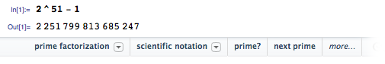
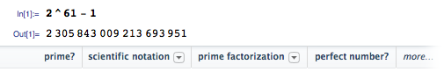
Notes:
Put a label of where this comes from: mathematica

Slide 29
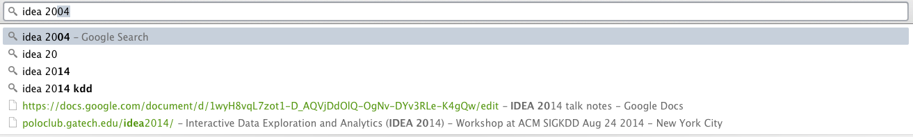
Notes:
To make this more readable, make your browser narrower and to control-plus to make this larger

Slide 30
data
action
Notes:
put this at the start in your recommendation motivation slides

Slide 32
Collect user goals and feedback.
Recommendation #4
Notes:
screen shot again of amazon and SYF

Slide 33
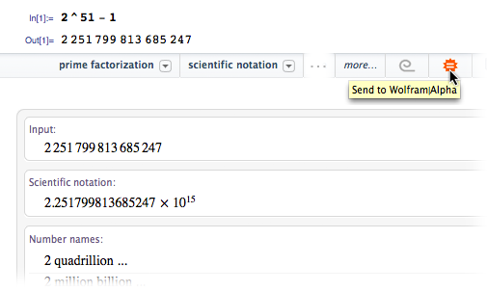

Slide 35
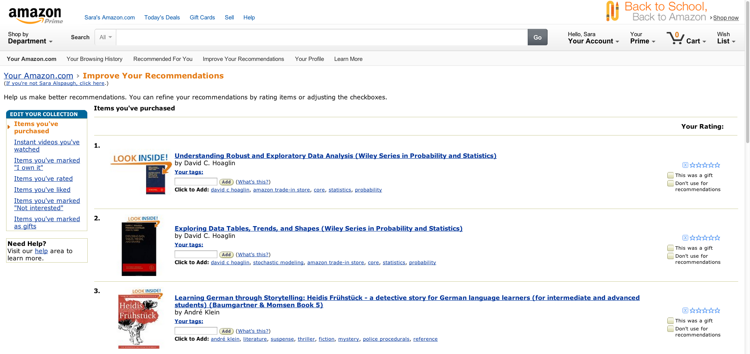

Slide 36
Work towards a standard for logging data analysis activity records.
Recommendation #5
Notes:
diagram showing input from all systems? not necessary
open source standards
put this last; requires the community coming together

Slide 37
Conclusion
goal: improve interactive data exploration and analysis (IDEA) interfaces, create recommender systems, guidelines, predictive suggestions
problem: need better data to mine
recommendations for IDEA activity record logs
when you build your next system for IDEA, will you consider how you log next?
Notes:
conclusion slide: state the opinion of the opinion piece: ending with the standard ; should summarize the points
started journey with wanting to solve the problem; tools are inaccurate.
found some issues when doing practical work
attempted here to make some recommendations
invite the community to join us in improving this vital situation for IDEA goals
when you build your next system, will you reconsider how you log next?

